Slide 1


Slide 2
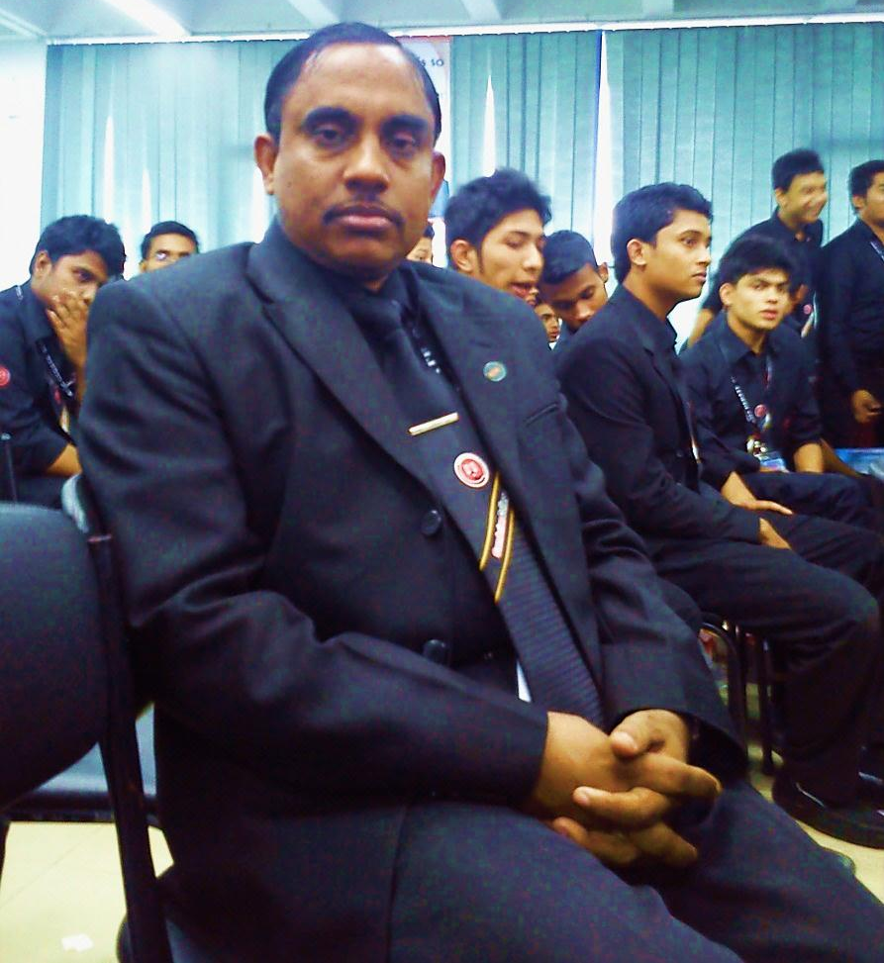
Introduction
Md Hasan Hafizur Rahman
Senior Lecturer
Department of English
Cambrian School & College
Dhaka

Slide 3
Traffic Jam

Slide 4
Let us discuss about a paragraph and it is-
A Traffic Jam

Slide 5
Learning Outcomes
After we have studied this lesson we will be able to----
Ask and answer questions
Know information
Practice writing
Write a paragraph

Slide 6
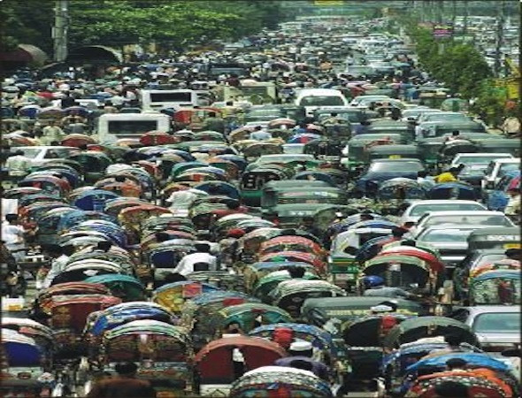
What is a traffic jam?
Traffic jam is a blockade of cars and vehicles on the road.

Slide 7
Where is it a common affair?
It is a common affair in big cities and towns in our country.

Slide 8
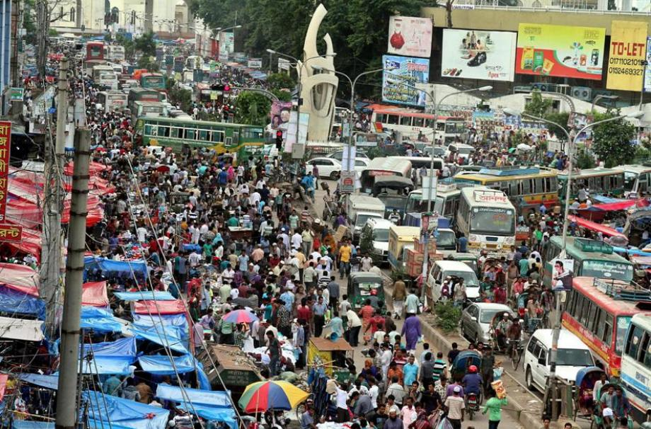
In which city is it seen frequently?
It is frequently seen in Dhaka city.

Slide 9
What are there behind the traffic jam?
There are some causes behind the traffic jam.

Slide 10
Which are they?
They are-

Slide 11
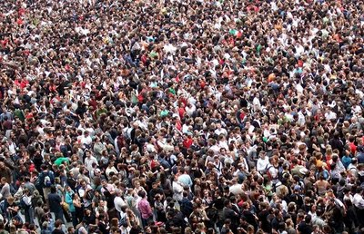
over population,

Slide 12
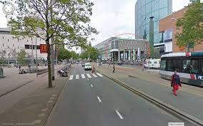
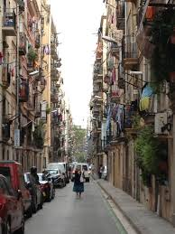
insufficient roads and streets
narrow roads,

Slide 13
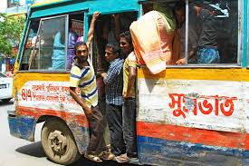
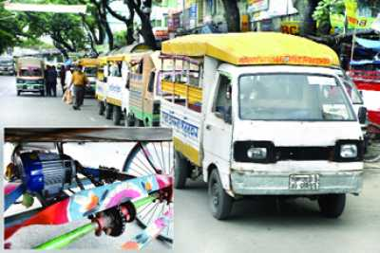
invalid cars and vehicles
unlicensed vehicles

Slide 14
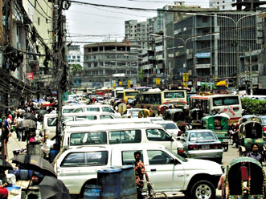
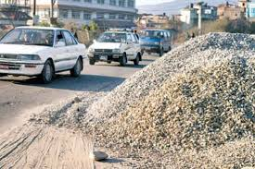
illegal parking
keeping construction materials on roads

Slide 15
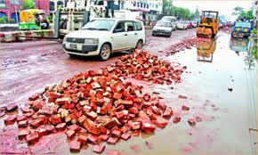
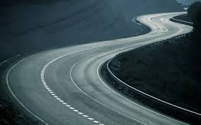
unplanned repairing
zigzag roads

Slide 16
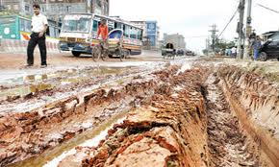
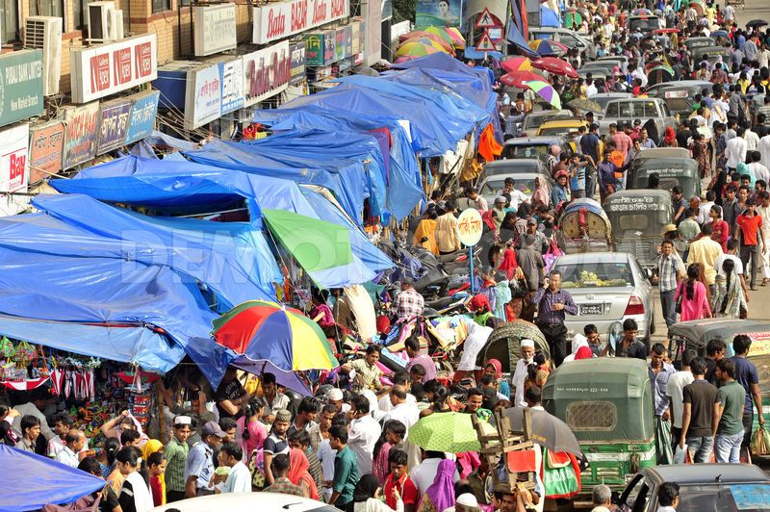
invalid roads
illegal markets on roads

Slide 17
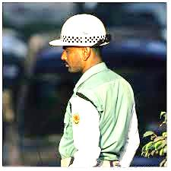
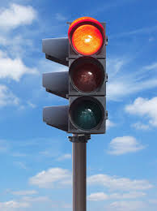
insufficient traffic police
irregular signal lights

Slide 18
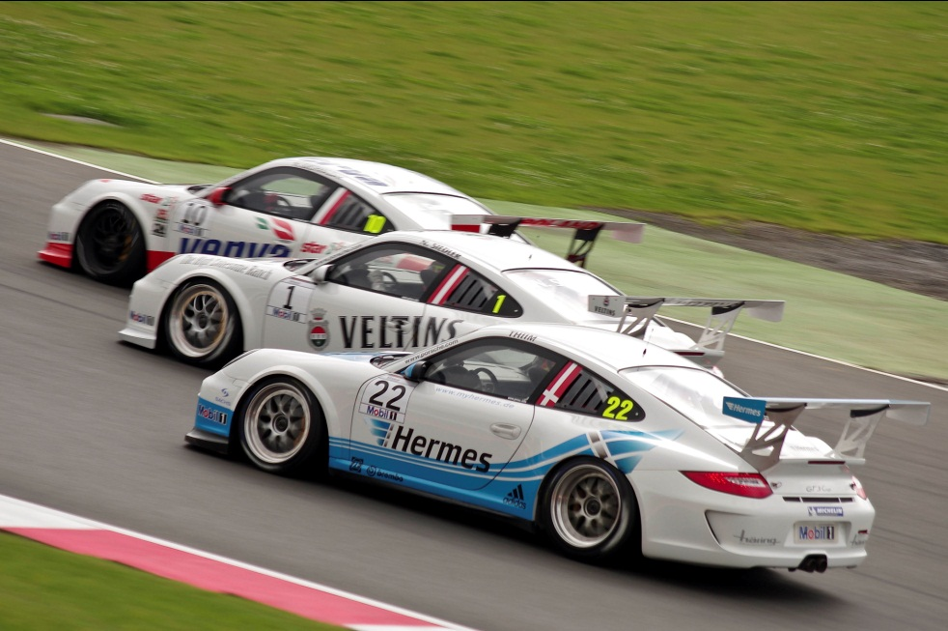
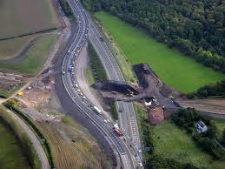
overtaking tendency
lack of by pass roads

Slide 19
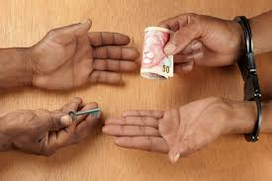
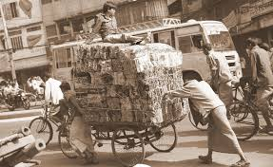
corruption of communication department
push cart, rickshaw and other non engine vehicles.

Slide 20
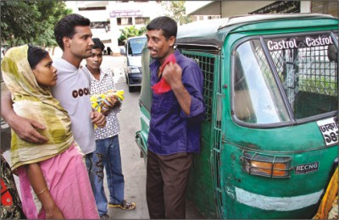
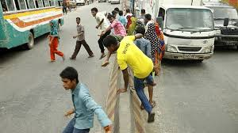
drivers’ whim
disobedience to law

Slide 21
and many other causes.

Slide 22
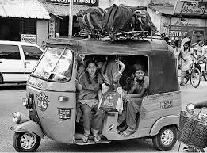
What problems are caused by traffic jam?
It causes many serious problems to the people.
Students cannot go to schools and colleges,

Slide 23
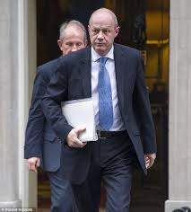
officers cannot go to their offices,

Slide 24
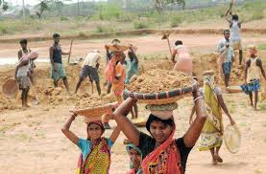
labourers cannot go to their workplaces,

Slide 25
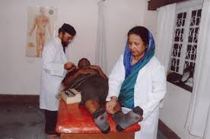
doctors cannot go to their chambers and hospitals,

Slide 26
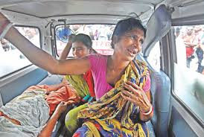
patients cannot go to hospitals in time.

Slide 27
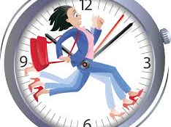
It kills our valuable time and our works are hampered.

Slide 28
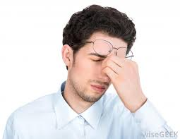
What is the effect of these problems?
Life becomes boring.

Slide 29
What should we do to solve these problems?
In order to solve these problems we should increase

Slide 30
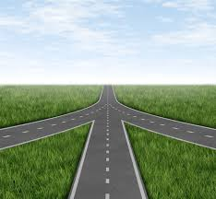
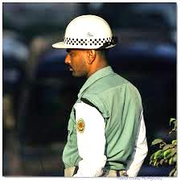
roads
traffic police

Slide 31
What are there more?

Slide 32
The government should implement traffic laws strictly, traffic police should be increased, corruption should be removed from the authority, roads and high ways should be kept free from building materials, temporary markets should be replaced to another places.

Slide 33
After all government and mass people should realize the bad effect of traffic jam and they all should come forward to solve these problems.

Slide 34
Group Works
Make a logical assemble with the words traffic, cars and vehicles, roads, rules, implemented, awareness, invalid, system, signal and other necessary words to write a paragraph by dividing groups each having 6 students.

Slide 35
Evaluation
Answer the following questions-
What is a traffic jam?
Where and why is it caused?
What is the problems of a traffic jam?
What should we do to get rid of traffic jam?

Slide 36
Home work
Write a paragraph on
“ A Traffic Jam.”

Slide 37
Verse
Life is more valuable than time.

Slide 38


